Slide 1
NodeJS & Its Components

Slide 2
NodeJS
Node.js is an open-source, cross-platform, asynchronous event-driven runtime environment for executing JavaScript code outside a browser.
Node.js runs the V8 JavaScript engine, the core of Google Chrome, outside of the browser.
A Node.js app runs in a single process, without creating a new thread for every request.
When Node.js performs an I/O operation, like reading from the network, accessing a database or the filesystem, instead of blocking the thread and wasting CPU cycles waiting, Node.js will resume the operations when the response comes back.
This allows Node.js to handle thousands of concurrent connections with a single server without introducing the burden of managing thread concurrency, which could be a significant source of bugs.

Slide 3
NodeJS
Node.js has a unique advantage because millions of frontend developers that write JavaScript for the browser are now able to write the server-side code in addition to the client-side code without the need to learn a completely different language.
In Node.js the new ECMAScript standards can be used without problems, as you don't have to wait for all your users to update their browsers.
You are in-charge of deciding which ECMAScript version to use by changing the Node.js version, and you can also enable specific experimental features by running Node.js with flags.

Slide 4
NodeJS Example
'
In the following "hello world" example, many connections can be handled concurrently. Upon each connection, the callback is fired, but if there is no work to be done, Node.js will sleep.
const http = require('http');
const hostname = '127.0.0.1';
const port = 3000;
const server = http.createServer((req, res)=>{
res.statusCode = 200;
res.setHeader('Content-Type', 'text/plain'); res.end('Hello World');
});
server.listen(port, hostname, () => { console.log(`Server running at http://${hostname}:${port}/`);
});

Slide 5
NodeJS Example
This is in contrast to today's more common concurrency model, in which OS threads are employed.
Thread-based networking is relatively inefficient and very difficult to use.
Furthermore, users of Node.js are free from worries of dead-locking the process, since there are no locks.
Almost no function in Node.js directly performs I/O, so the process never blocks except when the I/O is performed using synchronous methods of Node.js standard library.
Because nothing blocks, scalable systems are very reasonable to develop in Node.js.

Slide 6
NodeJS Example
HTTP is a first-class citizen in Node.js, designed with streaming and low latency in mind. This makes Node.js well suited for the foundation of a web library or framework.
Node.js being designed without threads doesn't mean you can't take advantage of multiple cores in your environment. Child processes can be spawned by using child_process.fork() API and are designed to be easy to communicate with.
Built upon that same interface is the cluster module, which allows you to share sockets between processes to enable load balancing over your cores.

Slide 7
Traditional Web Server Model
Any Web Application developed without Node JS, typically follows “Multi-Threaded Request-Response” model.
We can call this model as Request/Response Model. Client sends request to the server, then server do some processing based on client's request, prepare response and send it back to the client.
This model uses HTTP protocol. As HTTP is a Stateless Protocol, this Request/Response model is also Stateless Model. However, this model uses Multiple Threads to handle concurrent client requests.

Slide 8
Traditional Web Server Model: Processing Steps
Clients Send request to Web Server.
Web Server internally maintains a Limited Thread pool to provide services to the Client Requests.
Web Server is in infinite Loop and waiting for Client Incoming Requests
Web Server receives those requests.
Web Server pickup one Client Request
Pickup one Thread from Thread pool
Assign this Thread to Client Request
This Thread will take care of reading Client request, processing Client request, performing any Blocking IO Operations (if required) and preparing Response
This Thread sends prepared response back to the Web Server
Web Server in-turn sends this response to the respective Client.
Note – If more client requests require Blocking IO Operations, then almost all threads are busy in preparing their responses. Then remaining client Requests should wait for longer time.

Slide 9
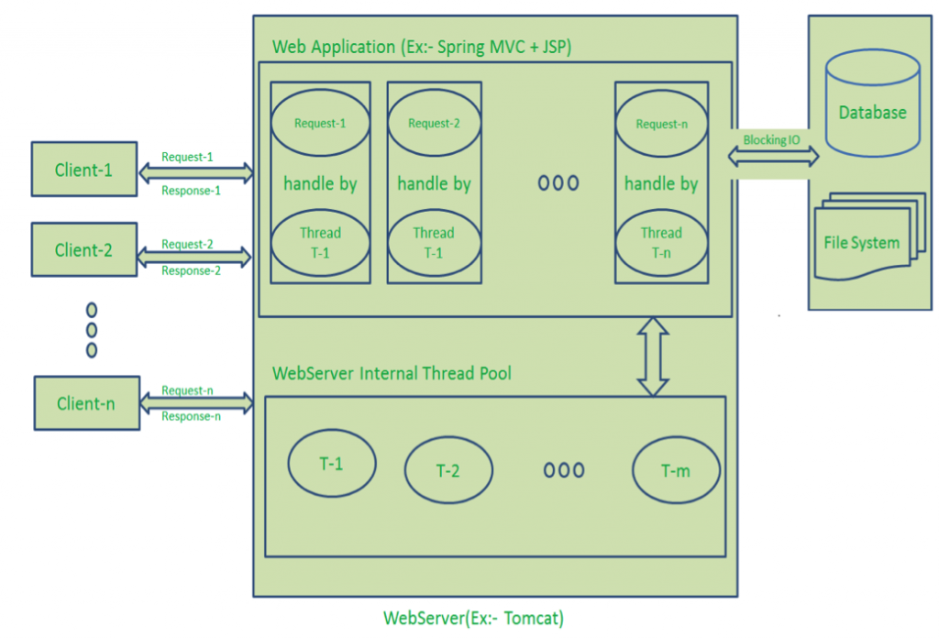

Slide 10
Traditional Web Server Model
Drawbacks of Request/Response Stateless Model:
Handling more and more concurrent client’s request is bit tough.
When Concurrent client requests increases, then it should use more and more threads, finally they eat up more memory.
Sometimes, Client’s Request should wait for available threads to process their requests.
Wastes time in processing Blocking IO Tasks.

Slide 11
NodeJS Architecture
Node JS Platform does not follow Request/Response Multi-Threaded Stateless Model.
It follows Single Threaded with “Event Loop” Model which is the main heart of Node JS Processing model.
Node JS Processing model mainly based on Javascript Event based model with Javascript callback mechanism.
As Node JS follows this architecture, it can handle more and more concurrent client requests very easily.

Slide 12
NodeJS : Single Threaded Event Loop Model Processing Steps
Clients Send request to Web Server.
Node JS Web Server internally maintains a Limited Thread pool to provide services to the Client Requests.
Node JS Web Server receives those requests and places them into a Queue. It is known as “Event Queue”.
Node JS Web Server internally has a Component, known as “Event Loop”. Why it got this name is that it uses indefinite loop to receive requests and process them.
Event Loop uses Single Thread only. It is main heart of Node JS Platform Processing Model.

Slide 13
NodeJS : Single Threaded Event Loop Model Processing Steps
Even Loop checks any Client Request is placed in Event Queue. If no, then wait for incoming requests for indefinitely.
If yes, then pick up one Client Request from Event Queue
Starts process that Client Request
If that Client Request Does Not requires any Blocking IO Operations, then process everything, prepare response and send it back to client.
If that Client Request requires some Blocking IO Operations like interacting with Database, File System, External Services then it will follow different approach
Checks Threads availability from Internal Thread Pool
Picks up one Thread and assign this Client Request to that thread.
That Thread is responsible for taking that request, process it, perform Blocking IO operations, prepare response and send it back to the Event Loop
Event Loop in turn, sends that Response to the respective Client.

Slide 14
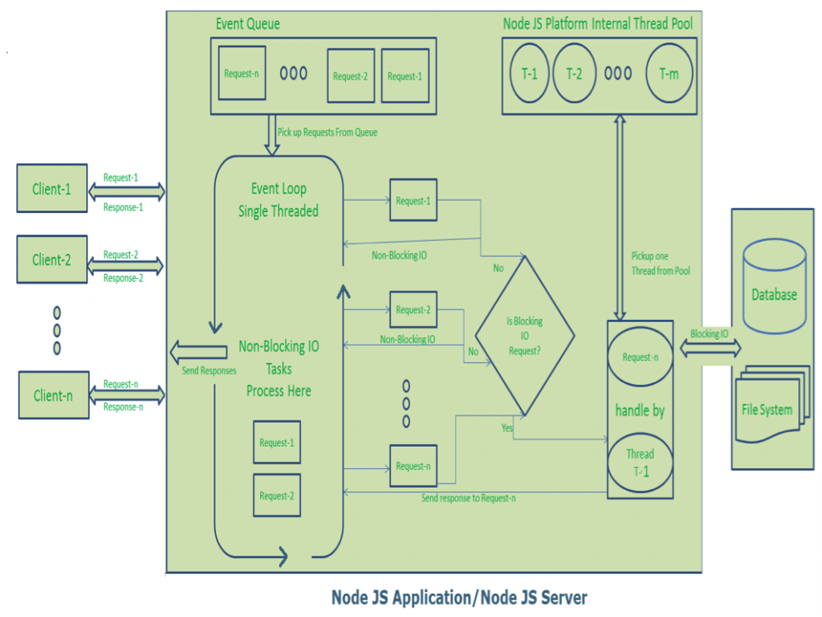

Slide 15
NodeJS : Event Loop Pseudo Code
public class EventLoop {
while(true) {
if(Event Queue receives a JavaScript Function Call) {
ClientRequest request = EventQueue.getClientRequest();
If(request requires BlokingIO or takes more computation time)
Assign request to Thread T1
Else
Process and Prepare response }
}
}

Slide 16
NodeJS : Single Threaded Event Loop Advantages
Handling more and more concurrent client’s request is very easy.
Even though our Node JS Application receives more and more Concurrent client requests, there is no need of creating more and more threads, because of Event loop.
Node JS application uses less Threads so that it can utilize only less resources or memory.

Slide 17
NodeJS : Installation
Access Node JS Official Website https://nodejs.org/en/
Download and install Node.js LTS version.
LTS is an abbreviation of the Long Time Support version where the release of the software is maintained for a more extended period of time.
Choose all Default values in the installation window and click on “Install” Button.

Slide 18
NodeJS : Environment Setup
Choose all Default values in the installation window and click on “Install” Button.
If we use Windows Installer like “node-v0.12.0-x64.msi” or exe file then we doesn’t need to do anything to SYSTEM variables. This installer will take care of everything.
If we use other formats or if these are missing in your system environment variables, please add the following variables to SYSTEM properties –
PATH=C:\Program Files (x86)\nodejs

Slide 19
NPM
NPM – or "Node Package Manager" – is the default package manager for JavaScript's runtime Node.js.
An online repository that hosts JavaScript packages
A CLI (command-line interface) tool for interacting with said repository that aids in package installation, version management, and dependency management
A plethora of Node.js libraries and applications are published on npm, and many more are added every day.
These applications can be searched for on https://www.npmjs.com/. Once you have a package you want to install, it can be installed with a single command-line command.

Slide 20
NPM
package.json file is generated when “npm init” is run to initialize a JavaScript/Node.js project, with these basic metadata provided by developers.
name: the name of your JavaScript library/project
version: the version of your project. Often times, for application development, this field is often neglected as there's no apparent need for versioning opensource libraies. But still, it can come handy as a source of the deployment's version.
description: the project's description
license: the project's license
scripts: These can be defined to run command-line tools that are installed in the project's local context.

Slide 21
NPM
dependencies : These dependencies are installed via the npm install command with --save flag for production environments.
devDependencies: can be installed using npm install --save-dev flag. They're meant to be used for development/test environments.
It's important to understand the possible signs that come before the semantic versions
^: latest minor release. For example, a ^1.0.4 specification might install version 1.3.0 if that's the latest minor version in the 1 major series.
~: latest patch release. For minor releases, ~1.0.4 specification might install version 1.0.7 if that's the latest minor version in the 1.0 minor series.
Note – All of these exact package versions will be documented inside a generated
package-lock.json file.

Slide 22
NPM
package-lock.json file describes the exact versions of the dependencies used in an npm JavaScript project.
If package.json is a generic descriptive label, package-lock.json is an ingredient table.
package-lock.json is usually generated by the npm install command, and is also read by our NPM CLI tool to ensure reproduction of build environments for the project with npm ci.

Slide 23
Modules & Their Types
Consider modules are the blocks of encapsulated code that communicates with an application on the basis of their related functionality.
The reason programmers are heavily reliant on modules is because of their re-usability as well as the ability to break down a complex piece of code into manageable chunks.
Modules are of three types:
Core Modules
local Modules
Third-party Modules

Slide 24
Installing NPM Packages
To install a package globally we use below command –
$npm install nodemon –g
To install a package locally we use below command –
$npm install nodemon - -save → to install as a dependency
$npm install nodemon - -save-dev → to install as a dev-dependency

Slide 25
Thank you!
Any Questions?

